Slide 1
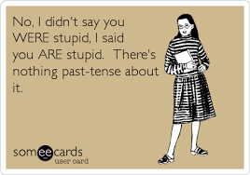
Timeline
What to learn for the test: Check your planner on Teams
Pointers for acing a reading test
Tenses recap
Excercise

Slide 2
Skill: Reading
Pointers for acing a reading test
Before you read
Analyse type text
Look at pictures
Read title and headings
Quickly scan questions
Whilst reading
First line paragraph is statement
Rest explanation + examples
Last line summation paragraph
Skimming text: quickly reading
Don’t use dictionary too much
Answering questions
First read question then text
Find the paragraph belonging to question
Scan for key words
When in doubt: Cross out definite wrong answers
Tips voor een top cijfer voor lezen
Voordat je start lezen
Analyseer tekstsoort
Bekijk de foto’s
Lees titel en tussenkopjes
Scan de vragen
Tijdens het lezen
Eerste zin alinea is statement
Rest is uitleg en voorbeelden
Laatste zin samenvatting alinea
Skimmen tekst: snel lezen
Gebruik woordenboek niet teveel
Beantwoorden van vragen
Lees eerst vraag dan pas tekst
Vind alinea dit hoort bij vraag
Scan voor belangrijke woorden
Als je twijfelt: Streep foute antwoorden weg

Slide 3
Tenses Recap
Past simple |  | Present simple |  | Will / Shall
I You She / He / It We / They |  | I You She / He / It We / They |  | I You She / He / It We / They
PAST |  | PRESENT |  | FUTURE
Present perfect |  | Present continuous |  | Going to
I You She / He / It We / They |  | I You She / He / It We / They |  | I You She / He / It We / They

Slide 4
Tenses Recap
Stappenplan
Bepaal welke tijd gebruikt is: Past, Present, Future?
Bepaal welke van de twee vormen van die tijd je moet gebruiken in deze zin
Pas hem toe

Slide 5
Tenses Recap
Stappenplan
Stap 1: Bepaal de tijd
Welke signifier staat er in de zin
I always …
Tomorrow I definitely …
Once before I …
Right now I …
Yesterday I …
Hopefully next week I …

Slide 6
Tenses Recap
Stappenplan
Stap 2: Bepaal de vorm
Past
Wittikwel = Past Simple
Witnie = Present Perfect
Present
Feiten = Present Simple
Nu aan de gang = Present Continuous
Future
Zekers = Going to
Nah, misschien = Will / Shall

Slide 7
Tenses Recap
Past simple Duidelijk wanneer |  | Present simple Feiten |  | Will / Shall Willen - niet zeker Shall: alleen vragen, alleen I + we
I You She / He / It We / They |  | I You She / He / It We / They |  | I You She / He / It We / They
PAST |  | PRESENT |  | FUTURE
Present perfect Onduidelijk wanneer |  | Present continuous Nu aan het doen |  | Going to Gaan doen – zeker weten
I You She / He / It We / They |  | I You She / He / It We / They |  | I You She / He / It We / They

Slide 8
Tenses Recap
Past simple Duidelijk wanneer |  | Present simple Feiten |  | Will / Shall Willen - niet zeker Shall: alleen vragen, alleen I + we
I You She / He / It We / They | worked worked worked worked | I You She / He / It We / They | work work works work | I You She / He / It We / They | will work will work will work will work | shall I work? - - shall we work?
PAST |  | PRESENT |  | FUTURE
Present perfect Onduidelijk wanneer |  | Present continuous Nu aan het doen |  | Going to Gaan doen – zeker weten
I You She / He / It We / They | have worked have worked has worked have worked | I You She / He / It We / They | am working are working is working are working | I You She / He / It We / They | am going to work are going to work is going to work are going to work

Slide 9
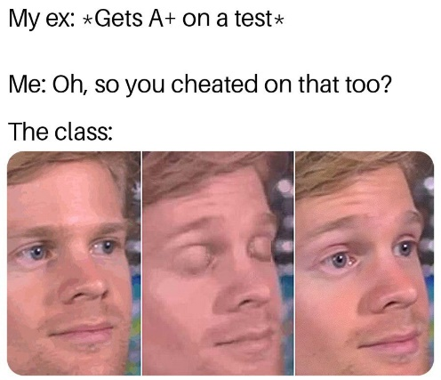
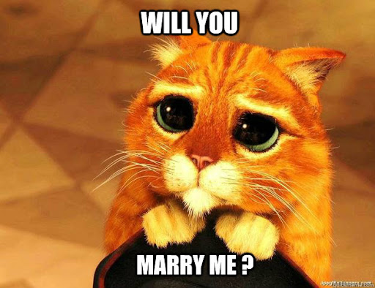
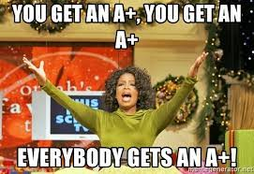
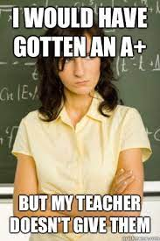
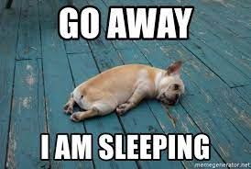
Tenses Recap
PAST | PRESENT | FUTURE
Present perfect | Present continuous | Going to

